Slide 1
Using Infographics in Chemistry
Lorri Weaver
Notes:
NTI: The introduction (slides 1-3) ensures the learners are introduced to what they will learn, where the lesson fits in to the course, why this lesson is important and how this lesson will flow. It is also important to include a control statement to set expectations for interactivity and a test statement to remind them of the test at the end of the course.
Speaker Notes (why lesson is important):
Good Morning everyone! As Ms. Lavigne said, my name is Lorri Weaver and my background is in instructional design which is basically creating learning experiences and materials that result in people acquiring and applying new knowledge, skills or attitudes. I did this in the Canadian Air Force which meant that most of the training I designed related to safety critical knowledge, skills or attitudes. You have been given the opportunity to help local parents with a safety critical topic and so I’m here to help set you up for that.

Slide 2
By the end of this lesson, you will be able to:
Explain what an infographic is
Complete the infographic design process
Notes:
Speaker Notes (lesson objectives, test statement and control statement):
Today’s lesson is really about setting you up for success in your project which culminates in you communicating with parents in your community about certain household chemicals. Although we are going to be talking about infographics, today, the process that we are going to go through can apply anytime you are communicating with a specific group, whether it is through a video, a presentation or even written text.
If you have any questions as we go along, please raise your hand and your teacher will help bring you to my attention because my view of you is a bit tiny. Because we’re setting you up for your project, you’re going to be doing some interactive activities and our time is short, so please try and be really focused with these.

Slide 3
Infographic: a representation of information in a graphic format designed to make the data easily understandable at a glance
Notes:
An infographic is a representation of information in a graphic format designed to make data easily understandable at a glance.

Slide 4
Studying Examples of Infographics
Open google
Search “Infographic” + topic (e.g. “infographic ski”)
View google images
Complete activity for 3 images:
Select and study infographic
Respond to questions
30 secs
30 secs
Notes:
We are going to start with an activity. When I say go, I would like you to open google, type the word infographic along with a topic of your choice. You could pick a hobby you have, a sport you like, an issue that interests you, or a place you are interested in visiting. For example, I could type “infographic ski”. After this, hit search and then view the images that come up.
Once you get to this point, raise your hand. Go ahead.
(pause, click)
Now, I’d like you to look at your student handout and on page 3, there is a chart with four questions that you are going to answer about three infographics you choose. These won’t be marked or handed in, but we will talk about your responses.
What was the main idea of the infographic or what big question did it answer?
Who is the target audience?
What did you like about the infographic or what made it easy for you to understand the message?
And finally What didn’t you like or what made it difficult to understand?
I am going to give you 30 seconds to select and study an infographic and then 30 seconds to write your answers to the four questions.
We are going to do this three times with different infographics. So now please click on and study one of the infographics. You have 30 seconds…

Slide 5
Studying Examples of Infographics
Focused
Ordered
Graphic
Notes:
With a show of hands, who was able to decide on what the main idea of all of the infographics they selected?
What things about the infographic made it easy for you to understand the message?
What things made it hard to understand?
(click)
A lot of what you discussed relates to these three ideas. A good infographic should be focused – it should have one central message or answer one main question. It should also be directed at specific audiences and all of the information presented should be significant and relevant to them.
The sequence that you look at the infographic should be obvious and there should be a path or flow that can be followed through the information.
And finally, infographics should be graphic. In essence, you are trying to tell a story using images and graphics. This is because these are often more quickly understood than text saying the same thing.
Image attribution:
ordered list by Wireform from the Noun Project
focus by Susannanova from the Noun Project
graphic by priyanka from the Noun Project

Slide 6
What is an Infographic?
Infographic Design Process
Notes:
Speaker Notes (lesson flow):
Now that we understand what a good infographic is, we are going to step through a process that you can use to help you design an infographic. Although we will be focusing on infographics, these steps will still apply if you decide to make a video instead.

Slide 7
Infographic Design Process
Identify the audience
Identify the message or question
Cite supporting facts
Consider how to convey the message
Show facts in a visual way
Develop wire diagram, sketch or storyboard
Select design tool
User testing
Notes:
This is an overview of the process that we are going to step through.

Slide 8
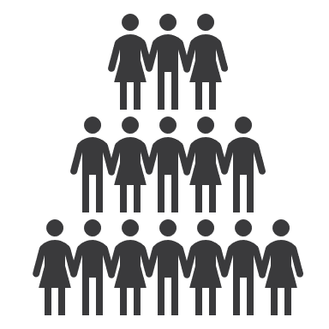
Identify the audience
Identify the message or question
Cite supporting facts
Consider how to convey the message
?
Name
Show facts in a visual way
Age:
Gender:
Education:
Jobs:
Language:
Interests:
Worries:
Develop wire diagram, sketch or storyboard
Select design tool
User testing
Notes:
We’re going to start with identifying the audience. When we are communicating with a group of people it is best to know as much as possible about that group. That way, you can speak to them directly and connect with their concerns or interests. So, I am going to give you a few minutes to ask your teacher questions about the members of the dragonfly parent group which is your primary audience.
Example question – What are their ages?
Now I want to ask you, for this project, do you have a secondary audience? Who else besides the parent group will be looking at your work? Your teacher…
This is very normal. Often if you were in a business designing an infographic, you would have a secondary audience consisting of lawyers, industry regulators or sponsors (who might insist you include or exclude certain information). You may not feel that you need to include the information to convey your message, but it must be included to satisfy your secondary audience. What is an example of this for this assignment? Atomic mass of ingredients.
(click)
One of the things that can help you relate to your audience is developing some personas which are pretend people in your audience. This way when you are thinking about your design, you can think about “Cathy” or “Bill”. We don’t have time to work through personas right now, but I have included some templates in your student workbook that you can fill in later.

Slide 9
Identify the audience
Identify the message or question
Main message or question:
____________________________________
____________________________________
____________________________________
____________________________________
____________________________________
Cite supporting facts
Consider how to convey the message
Show facts in a visual way
Develop wire diagram, sketch or storyboard
Select design tool
User testing
Notes:
After you identify your target audience, you are going to identify the main message you want to convey or the question that you want to answer. Take a minute to write down what you think is the main message or question for your assignment.
Does anyone want to share what they have written?
This main message or question should be something that you keep coming back to. It is also okay to change it as you get more information.

Slide 10
Identify the audience
Identify the message or question
Cite supporting facts
Information checklist:
Reference cited
Connects to main message/question or mandated requirement
Consider how to convey the message
Show facts in a visual way
Develop wire diagram, sketch or storyboard
Select design tool
User testing
Notes:
Your next step is to research information related to your topic. I have provided some space in your student workbook for this, but the two things that you want to remember are to cite the sources that you get your information from and ensure that all the information that you collect either relates to your main message or question or addresses specific requirements you have been given. Including information that is unrelated to the main message or question you are trying to answer will confuse your audience as the focus of your graphic will become unclear.

Slide 11
Cite supporting facts
Ethyl Acetate
Fact | Reference | How does it relate to my audience?
Notes:
Although we don’t have time to research all the facts right now, I want you to pretend that you have chosen a compound containing ethyl acetate. Using your chromebooks, take 5 minutes to find one useful fact about ethyl acetate that you think members of the dragonfly parent group would find useful. Write the fact down, cite your reference and explain how it relates to your target audience. Some examples of interesting facts are the toxicity, can it be absorbed through the skin, if it’s ingested what should you do? We are going to use the fact you find in the other parts of this lesson. You have five minutes starting now.
(5 minutes)
In your books, I have included space for other research notes that you can put in that relate to your project. But for now, we are going to move on to the next step.

Slide 12
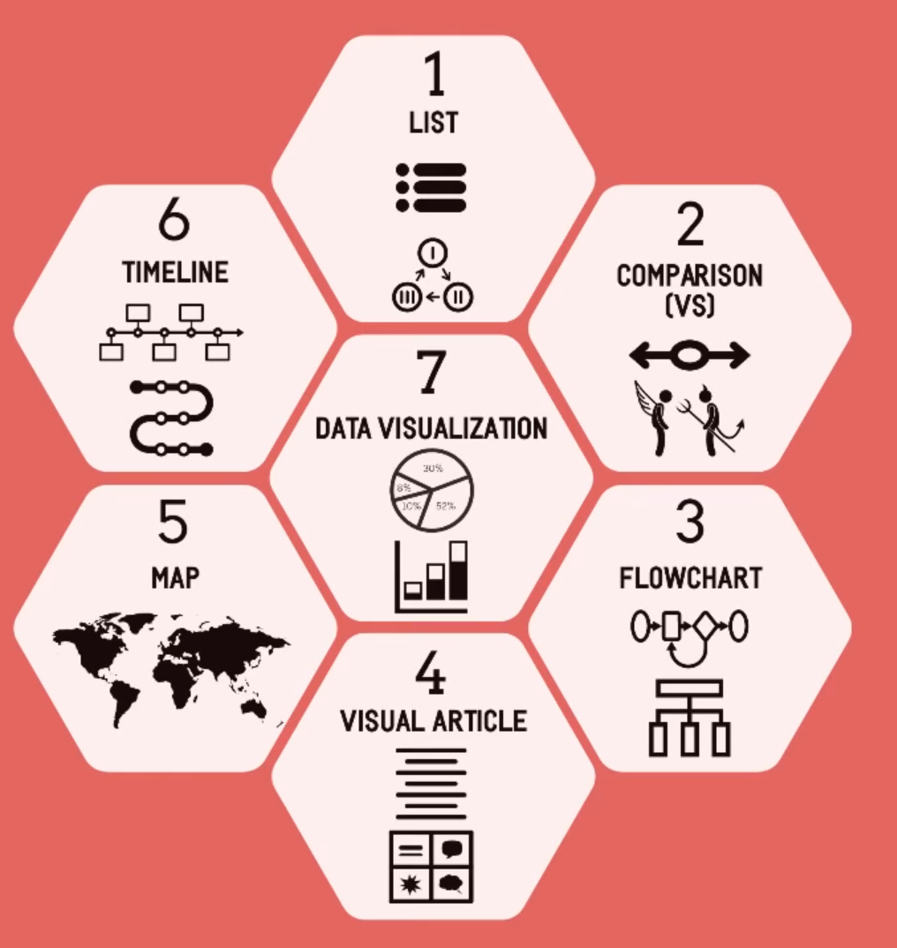
Identify the audience
Types of Infographics
Identify the message or question
Cite supporting facts
Consider how to convey the message
Show facts in a visual way
Develop wire diagram, sketch or storyboard
Select design tool
User testing
Notes:
Now we come to the really creative parts of your assignment. This is where you are going to decide how you want to convey your message. Do you want to use an infographic and if so, what type?
We are going to watch a quick video that talks about some main types of infographics:
https://youtu.be/A6_7zC0mB9w
A good exercise is to think about how you could use each type of infographic. Thinking about the fact that you discovered about ethyl acetate, could you use the fact as part of a story shown on a timeline, as part of a flowchart or in a comparison chart?

Slide 13
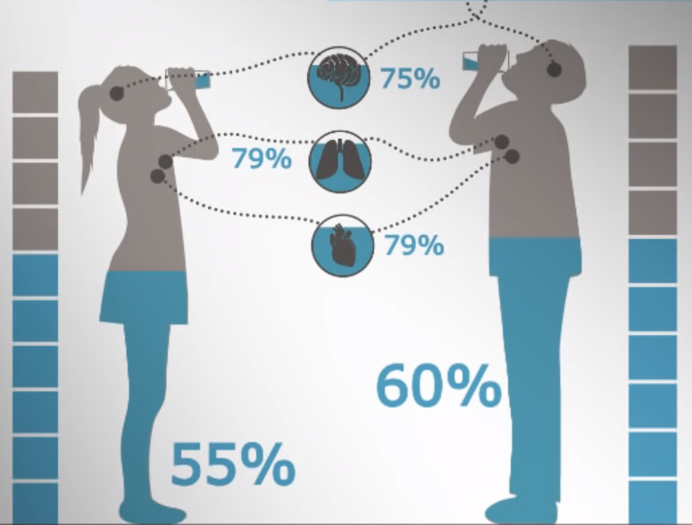
Identify the audience
Identify the message or question
Cite supporting facts
Consider how to convey the message
Show facts in a visual way
Develop wire diagram, sketch or storyboard
Select design tool
User testing
Notes:
This relates to the next part which is how to show facts in a visual way.
From the video that we just watched, this is one part of an infographic that was shown. Just from looking at this infographic, what is one fact that it is asserting?
75% of the brain is made up of water or 55% of a women’s body is made up of water.

Slide 14
Identify the audience
Identify the message or question
75% of the human brain is made up of water
79% of the human lungs are made up of water
79% of the human heart is made up of water
A women’s body is made up of 55% water
A man’s body is made up of 60% water
Cite supporting facts
Consider how to convey the message
Show facts in a visual way
Develop wire diagram, sketch or storyboard
Select design tool
User testing
Notes:
Compare the image to the text version of the facts. If I told you that the main message being conveyed was “Drinking water is important”, which version better supports this?

Slide 15
Identify the audience
Identify the message or question
Cite supporting facts
Consider how to convey the message
Show facts in a visual way
Circle 75% full
75% of the human brain is made up of water
Develop wire diagram, sketch or storyboard
Context
Select design tool
Icon
Color
User testing
Notes:
When we look at how they translated their facts to the graphic, we can see that they took apart each part of the fact. For example to represent the human brain, they used an icon or a simple representation of the brain that is easily recognized and to represent water, they used color in a specific context.
When we are representing things visually, we want to really think about our audience. If this graphic was for a group of 5 year olds for example, they might not recognize the icon of the brain and so the graphic might need to be simplified to contain less information.

Slide 16
Showing a fact visually
Do a rough doodle to represent the main parts of your fact.
Icon?
Graph/chart?
Color?
Notes:
Using the fact that you learned about Ethyl Acetate, pick out the main words or the main idea and think about how it could be represented visually. Do a rough doodle to show how the idea or some of the main words might be represented with minimal text.

Slide 17
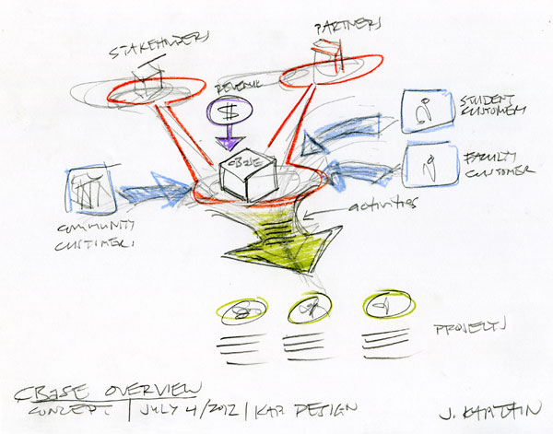
Identify the audience
Identify the message or question
Cite supporting facts
Consider how to convey the message
Show facts in a visual way
Develop wire diagram, sketch or storyboard
Select design tool
User testing
Notes:
Now that you have brainstormed different ways you can visualize your information, the next step is to plan out your graphic as a whole. You can sketch it out on a piece of paper or use block shapes to represent different parts of your graphic. Your sketch doesn’t have to be neat or pretty, it just needs to capture your ideas. When you’re planning your graphic, you want to keep in mind four principles of design.
Image attribution:
https://kapdesign.files.wordpress.com/2012/10/cbase_overview_sketch1_kap.jpg

Slide 18
Identifying Design Principles
Images taken from Williams (2008)
Notes:
Instead of telling you the design principles, I’d like you to look at the graphic on the right and tell me why it is better than the one on the left.
Contrast – make things (color, font, size, shape) the same or very different
Repetition – repeat visual elements (shapes, colors, texture, graphic concepts, font) to unify your design
Alignment – elements should be visually connected and share the same alignment
Proximity – group related things, leave space between unrelated things
Image attribution: Williams, R. (2008). The Non-designer’s design book (3rd ed.). Peachpit Press.

Slide 19
Design Principles
Identify the audience
Identify the message or question
Contrast – make things (color, font, size, shape) the same or very different
Repetition – repeat visual elements (shapes, colors, texture, graphic concepts, font) to unify your design
Alignment – elements should be visually connected and share the same alignment
Proximity – group related things, leave space between unrelated things
Cite supporting facts
Consider how to convey the message
Show facts in a visual way
Develop wire diagram, sketch or storyboard
Select design tool
User testing
Notes:
These are the four design principles that we talked about.

Slide 20
Color
Identify the audience
Identify the message or question
Tell a story
Established color scheme
Emphasis
Group information
Cite supporting facts
Consider how to convey the message
Show facts in a visual way
Develop wire diagram, sketch or storyboard
Select design tool
User testing
Notes:
When we think about color, we first want to use color to tell our story. Does the product that you are featuring already have a color pallet you want to use? If not, are there certain colors that relate to the ideas you want to communicate. And finally, can you use color to make your main ideas stand out or to group information?
In this infographic, we can see that they used the same light blue color for the text “slope-ready” and the boxes containing the related information. Color helps with contrast, making the people stand out and repetition between the two people, the mountains and the information boxes.

Slide 21
Select a color pallet
Go to this link:
https://color.adobe.com/create/color-wheel
Select a color pallet you could use with your fact
Copy the HTML color code
Notes:
I want you to try out an online tool for selecting a color pallet. Think about the ethyl acetate fact that you found out and if it relates to a color in some way.
Go to the adobe color wheel link.
Use your mouse to select the bubble with the little arrow in it. Drag this to an initial color and then look at different options for color pallets. Note that you can also slide the bubble around and see how it adjusts the color pallet.
Copy the HTML color code or the RGB code that is found under the color swatch
You can also use this tool to extract a gradient or a theme from an image and you can see how a color blind person would view your color pallet.

Slide 22
Font
Identify the audience
Identify the message or question
1 font or 2 contrasting fonts
Cite supporting facts
Consider how to convey the message
Show facts in a visual way
Develop wire diagram, sketch or storyboard
Select design tool
User testing
Notes:
When you choose a font to use, I would recommend using either one font for the whole graphic or choose two fonts that contrast. If you choose to use decorative or script fonts, they should relate to either the mood you are trying to set or to the story you are telling. These need to be used sparingly as they are more difficult to read. There is a lot of other information about fonts that we could cover, but there just is not the time.

Slide 23
Choose a Design Tool
Identify the audience
Identify the message or question
Cite supporting facts
Paper & pencil
Powerpoint
Canva.com
Piktochart.com
Easel.ly
Consider how to convey the message
Show facts in a visual way
Develop wire diagram, sketch or storyboard
Select design tool
User testing
Notes:
Once you have an idea of how you want your infographic to look, you can choose your design tool. You can go old school with art supplies, use powerpoint (lots of templates exist for infographics for powerpoint) or you can use one of the online infographic tools. Canva is a good online tool as it allows you to download full resolution versions of your graphic, but there are other tools available as well. I have listed a few in your handout.
Paper and a pen
Powerpoint (with templates or create your own)
canva.com (free account allows download of high resolution version, tutorials)
Piktochart.com (free account allows download of medium resolution .png and shareable link to electronic version)
easel.ly (free account allows you to download low resolution versions and get a shareable link to the electronic version)

Slide 24
User Testing
Identify the audience
Identify the message or question
Cite supporting facts
Consider how to convey the message
?
Show facts in a visual way
Develop wire diagram, sketch or storyboard
Select design tool
User testing
Notes:
This last step is when you get feedback to find places you can improve. Try to test your infographic with one or more people who is similar to your target audience (in this case a parent of a young child). Ask them questions like:
What question does this infographic answer?
What is the main idea of this infographic?
Was anything confusing?
Was there anything you did not understand?
What jumped out at you?
What did you like most?

Slide 25
Notes:
Speaker Notes (Key Takeaways/Questions):
I would now like you to take out your notetaking page for this lesson. Take a minute to write down some of the key takeaways that you had from this lesson. Stuff you want to remember for your project work as well as any questions you still have.

Slide 26
Non-Designers Design Book
Robin Williams
26
Notes:
A very good reference if you are seeking additional information.

